Slide 1
Quantifying the Breadth of Vaccine Responses
Amanda Skarlupka
11/4/21

Slide 2
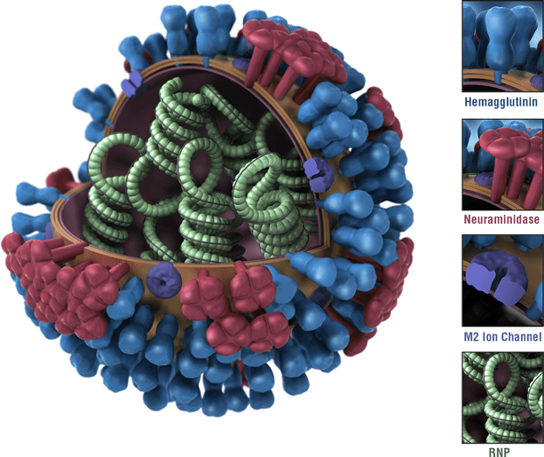
Influenza virus
Influenza A Virus Particle
Respiratory (-) ssRNA virus
Two major surface proteins
Hemagglutinin
Attachment/Fusion
18 subtypes
Neuraminidase
Motility and Budding
11 subtypes
Correlates of protection:
HA inhibiting antibodies – Well accepted
NA inhibiting antibodies – Recently proposed
Image from: https://www.cdc.gov/flu/about/viruses/types.htm

Slide 3
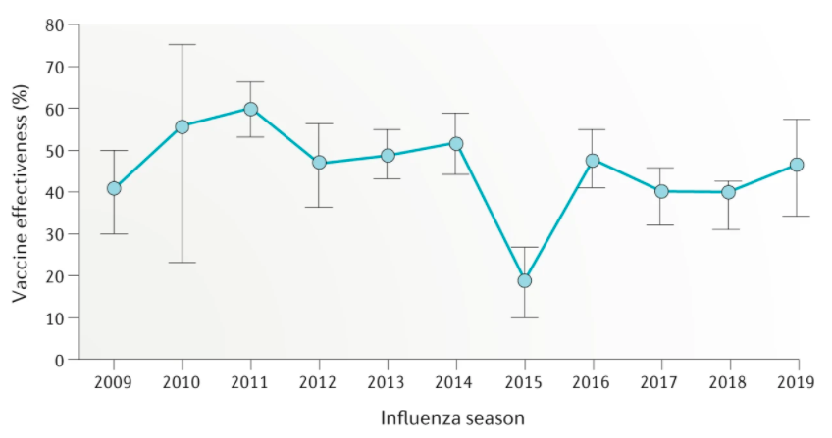
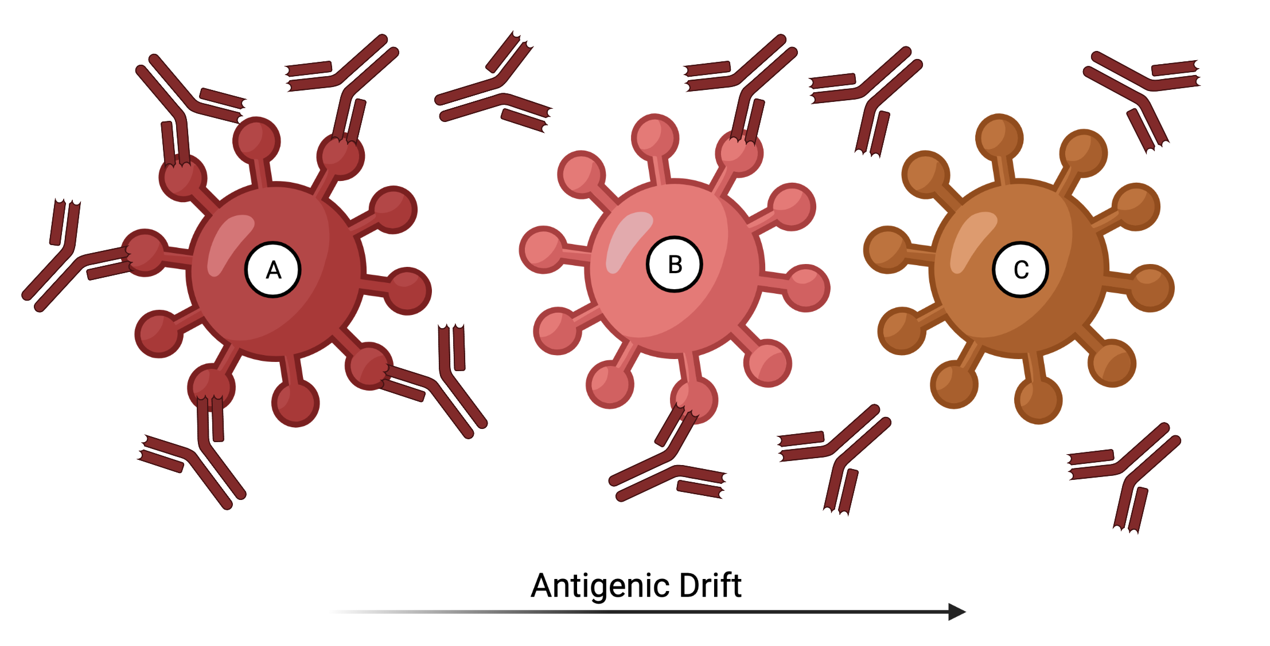
Influenza vaccines
Current influenza vaccine effectiveness maintained between 40-60%
Split-inactivated virus vaccines
H1N1
H3N2
Yamagata Lineage
Victoria Lineage
Standard-of-care
Insufficiently induces protection to genetically/antigenically drifted viruses
Wei, CJ., Crank, M.C., Shiver, J. et al. Next-generation influenza vaccines: opportunities and challenges. Nat Rev Drug Discov 19, 239–252 (2020). https://doi.org/10.1038/s41573-019-0056-x
Created with BioRender.com

Slide 4
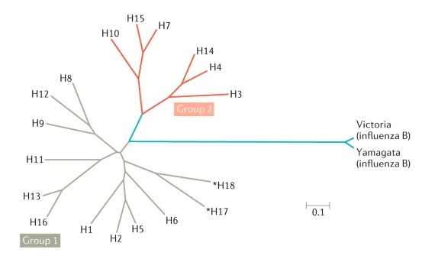
Next Generation of Influenza Vaccines
Vaccine | Breadth
Strain-specific | Current Circulating Strain
Subtype-specific | Multiple strains within a subtype (H1 or H3)
Group-specific | Multiple subtypes within a group
Pan-group | Entire Group
Universal Flu A | All Influenza A
Universal Flu | All influenza A and B
Wei, CJ., Crank, M.C., Shiver, J. et al. Next-generation influenza vaccines: opportunities and challenges. Nat Rev Drug Discov 19, 239–252 (2020). https://doi.org/10.1038/s41573-019-0056-x

Slide 5
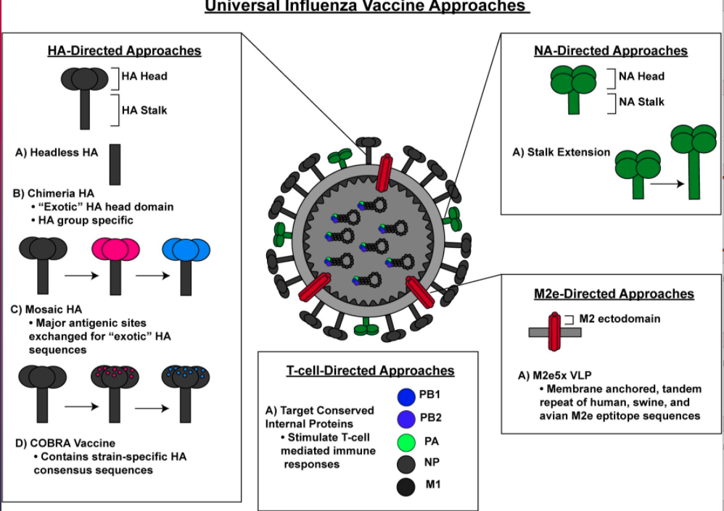
Candidates in Development
Including additional:
Adjuvants
Mixtures of candidates
Delivery platforms
Intramuscular
Skin patch
Intranasal

Slide 6
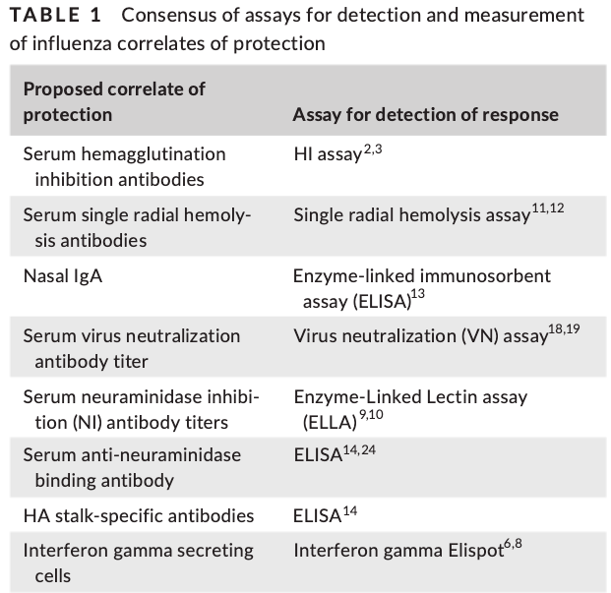
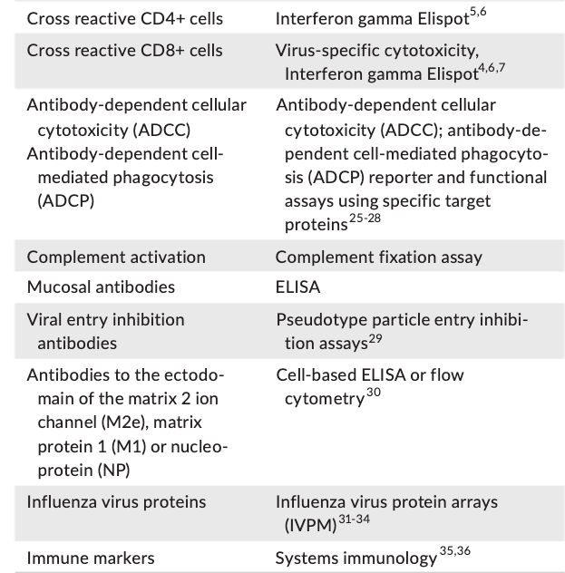
Efficacy of Vaccine Candidates
Challenge results
Animal model directly infected with virus
Survival, weight loss, clinical scores, viral load
Magnitude of antibody response
Viral breadth of antibody response
Functionality of the antibody response
Krammer F, Weir JP, Engelhardt O, Katz JM, Cox RJ. Meeting report and review: Immunological assays and correlates of protection for next-generation influenza vaccines. Influenza Other Respir Viruses. 2020 Mar;14(2):237-243. doi: 10.1111/irv.12706. Epub 2019 Dec 13. PMID: 31837101; PMCID: PMC7040967.

Slide 7
Conclusion: Correlates of protection
Different assays for different vaccine type
Not standardized or harmonized across labs yet
Measure the magnitude of the immune response
However, how is the viral breadth of the immune response measured?

Slide 8
Viral Breadth Determination
Conduct the correlate of protection assay against:
Homologous virus
Heterologous viruses
Compare results
How to compare the results from between different vaccine candidates to choose the one with the broadest breadth and sufficient magnitude of response?

Slide 9
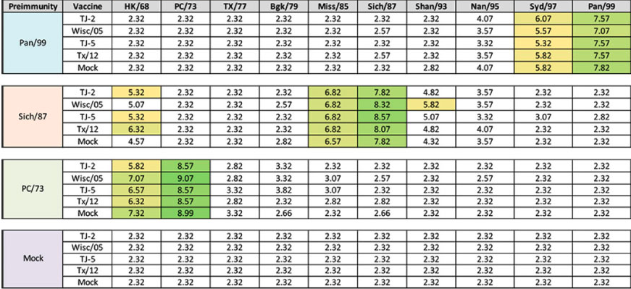
Most common method: Count the strains
Researcher chooses the breadth panel
May not be the same strains chosen by other groups
Ideally representative strains from different ‘eras’
Potential bias of inclusion of more related recent isolates
2010-2019 = 9 strains
2000-2009 = 6 strains
1990-1999 = 4 strains
1980-1989 = 2 strains
1970-1979 = 3 strains
1968-1969 = 1 strain
Allen, 2021. Evaluation of Next-Generation H3 Influenza Vaccines in Ferrets Pre-Immune to Historical H3N2 Viruses. 10.3389/fimmu.2021.707339

Slide 10
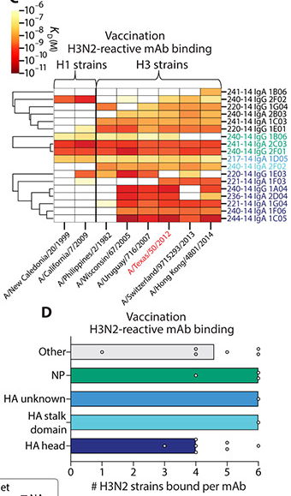
Count the Strains
Depends on the strains chosen
Usually selected from previously determined “antigenic clusters” or genetic clades
Open to researchers choosing strains that they know will react positively for desired outcome
Dugan, H. L., Guthmiller, J. J., Arevalo, P., Huang, M., Chen, Y. Q., Neu, K. E., Henry, C., Zheng, N. Y., Lan, L. Y., Tepora, M. E., Stovicek, O., Bitar, D., Palm, A. E., Stamper, C. T., Changrob, S., Utset, H. A., Coughlan, L., Krammer, F., Cobey, S., & Wilson, P. C. (2020). Preexisting immunity shapes distinct antibody landscapes after influenza virus infection and vaccination in humans. Science translational medicine, 12(573), eabd3601. https://doi.org/10.1126/scitranslmed.abd3601

Slide 11
How to quantify the differences between strains?
Year of isolation
Not representative of antigenic relatedness
Glycosylation/mutations and Antigenic shifts
Genetic differences
Genetic cluster do not always match antigenic clusters
Methods are becoming more refined
Antigenic cartography
Multiscale dimensional scaling analysis of antibody responses to a distance value

Slide 12
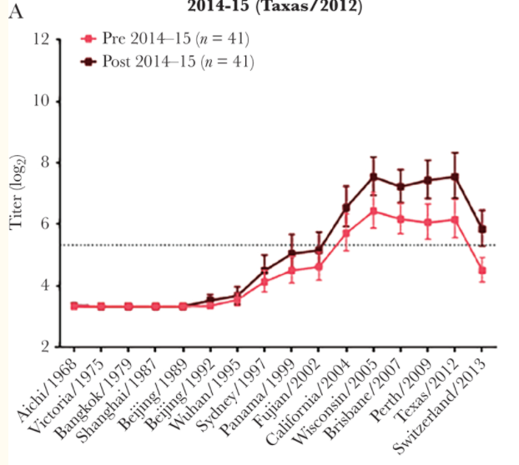
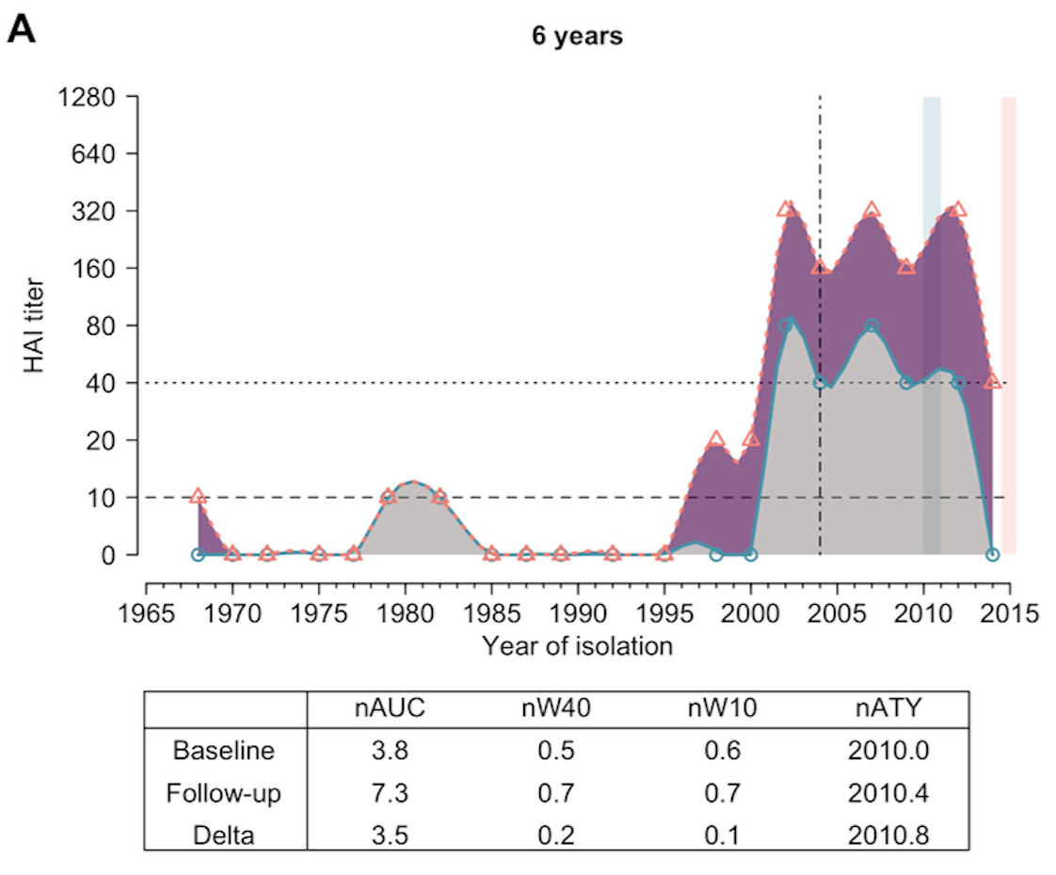
Year of Isolation
X-axis
Representative viruses are chosen again (chronological)
Virus year of isolation
Y-axis
assay result
Does not account for changes in the rate of antigenic drift
Hinojosa M, Shepard SS, Chung JR, et al. Impact of Immune Priming, Vaccination, and Infection on Influenza A(H3N2) Antibody Landscapes in Children. J Infect Dis. 2021;224(3):469-480. doi:10.1093/infdis/jiaa665
Yang B, Lessler J, Zhu H, Jiang CQ, Read JM, Hay JA, et al. (2020) Life course exposures continually shape antibody profiles and risk of seroconversion to influenza. PLoS Pathog 16(7): e1008635. https://doi.org/10.1371/journal.ppat.1008635

Slide 13
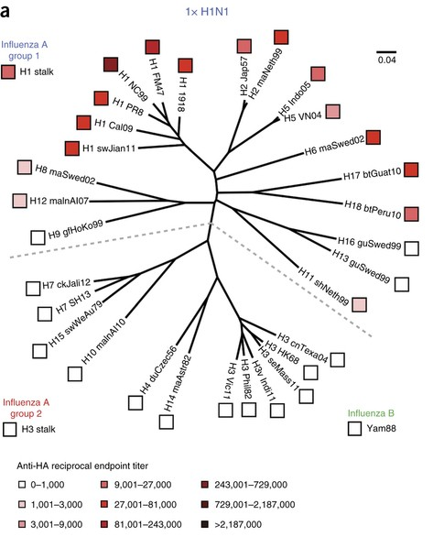
Genetic Differences
Nachbagauer, R., Choi, A., Hirsh, A. et al. Defining the antibody cross-reactome directed against the influenza virus surface glycoproteins. Nat Immunol 18, 464–473 (2017). https://doi.org/10.1038/ni.3684
Response is depicted on a phylogenetic tree
Genetic relatedness
Magnitude of response
Easier to interpret which strains are more related and more likely to cross-react
Genetic clusters do not always match antigenic clusters
H2 viruses genetic clades highly cross-reactive

Slide 14
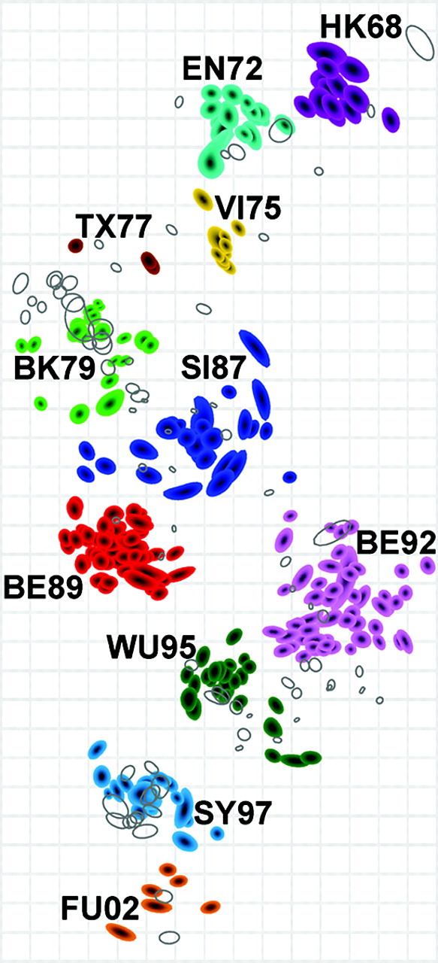
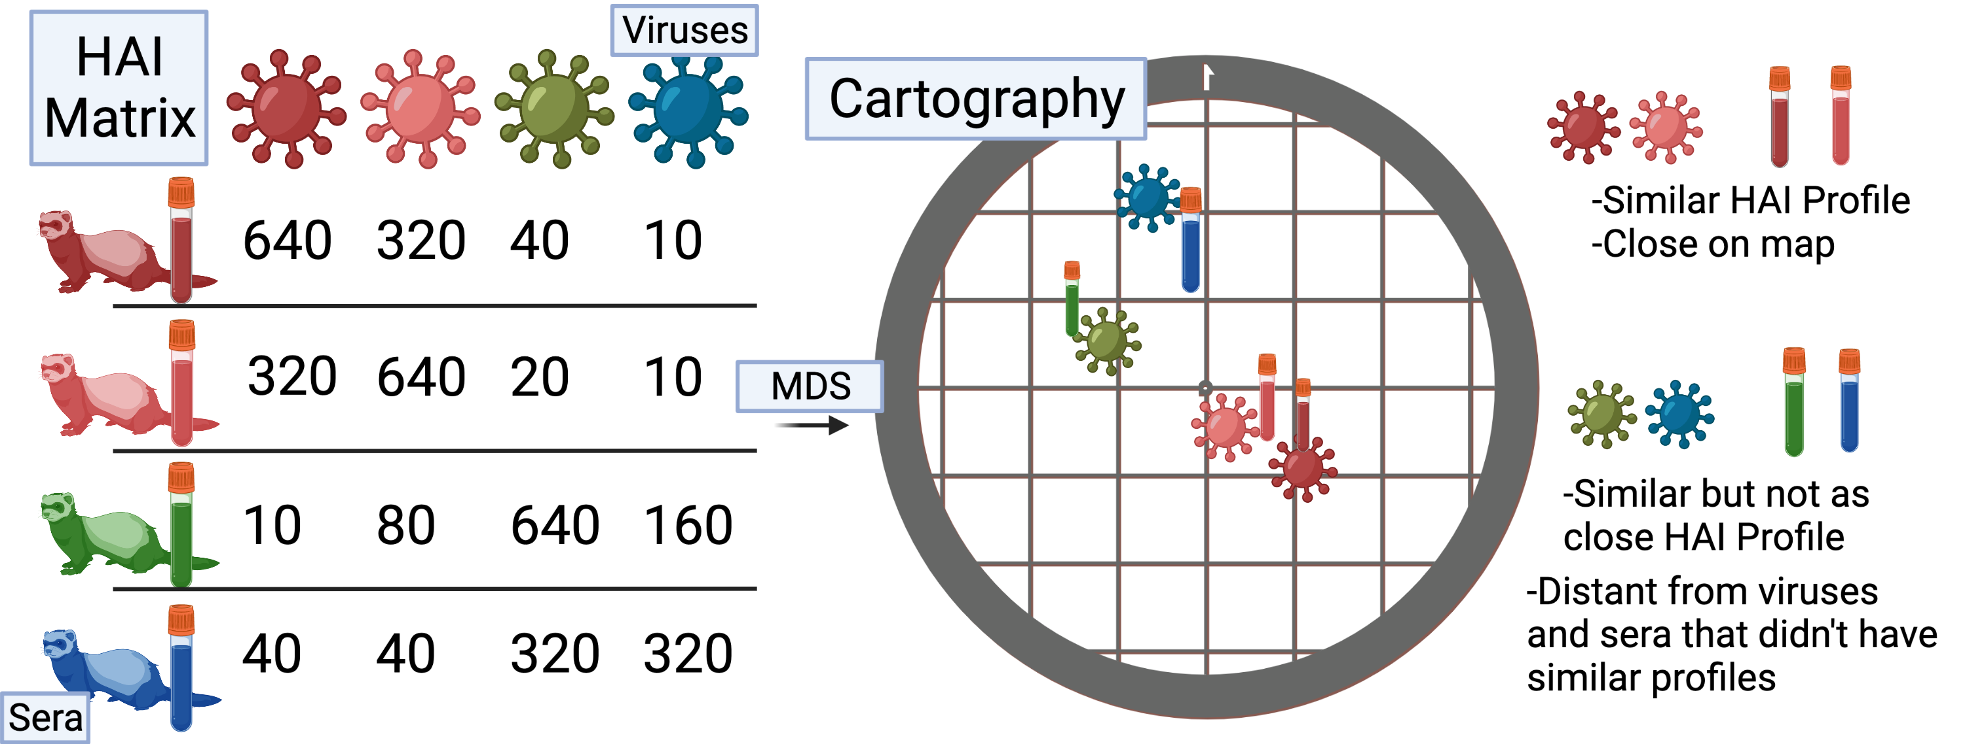
Antigenic Cartography
Smith DJ, Lapedes AS, de Jong JC, Bestebroer TM, Rimmelzwaan GF, Osterhaus AD, Fouchier RA. Mapping the antigenic and genetic evolution of influenza virus. Science. 2004 Jul 16;305(5682):371-6. doi: 10.1126/science.1097211. Epub 2004 Jun 24. PMID: 15218094.
From the experimental antibody data (HAI titers) create a matrix of [sera x virus]
Grid lines are Antigenic distance units
1 unit = 1 2-fold change in HAI titer
Distances between viruses can be used as a measurement
Antigenic
Drift
Over
Time
Created with BioRender.com

Slide 15
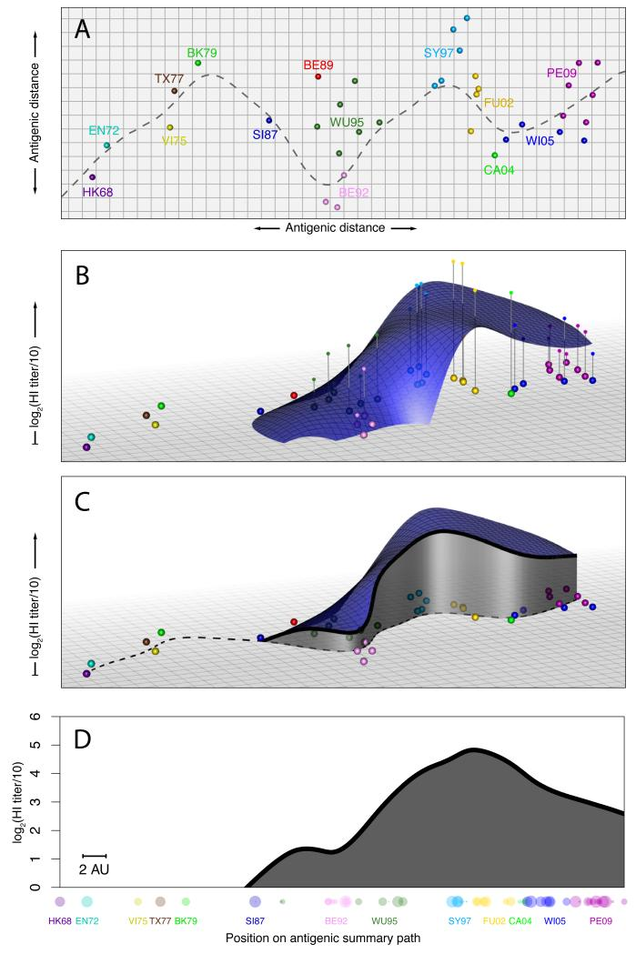
Landscapes include antigenic distance information
Goal: Visualize individual’s breadth to antigenic history
Antigenic cartography
Summary path using time of isolation
Use the individual’s serum titers to the viruses in the Z-axis. Fit locally-weighted multiple linear regression surface
Follow the summary path
Reduce to 2 dimensions
Fonville JM, Wilks SH, James SL, et al. Antibody landscapes after influenza virus infection or vaccination. Science. 2014;346(6212):996-1000. doi:10.1126/science.1256427

Slide 16
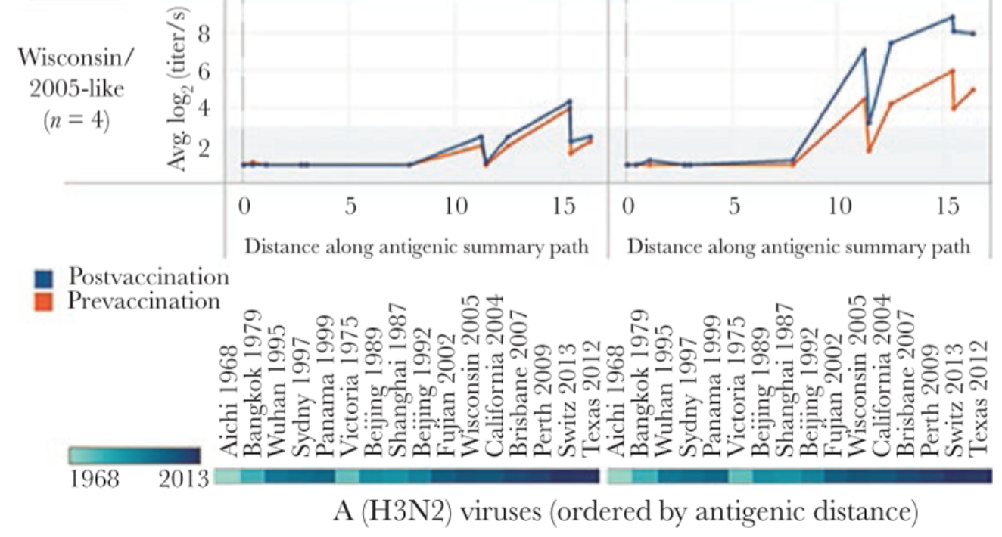
Antigenic Landscapes with Summary Path
X-axis is the antigenic distance from the cartography results
Reference point usually starts at 1968 virus
Antigenically related viruses are have shorter distances
Strain-specific responses will be steep peaks
Broadly-reactive will be hills
2014-2015 (Texas/2012)
Season 1
2015-2016 (Swit/2013)
Season 2
Hinojosa M, Shepard SS, Chung JR, et al. Impact of Immune Priming, Vaccination, and Infection on Influenza A(H3N2) Antibody Landscapes in Children. J Infect Dis. 2021;224(3):469-480. doi:10.1093/infdis/jiaa665

Slide 17
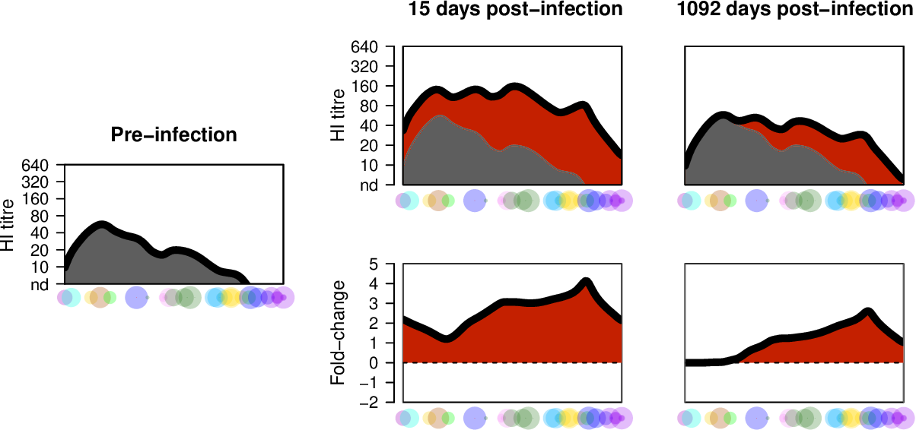
Antigenic Landscape profiles
Previously used to look at:
Back-boosting
Predicting infection history
Breadth of IgG responses
An individual’s antibody profile
Wilks, S. (2017). Visualisation and analysis of patterns in serological data using "antibody landscapes". PhD Disseration. UK

Slide 18
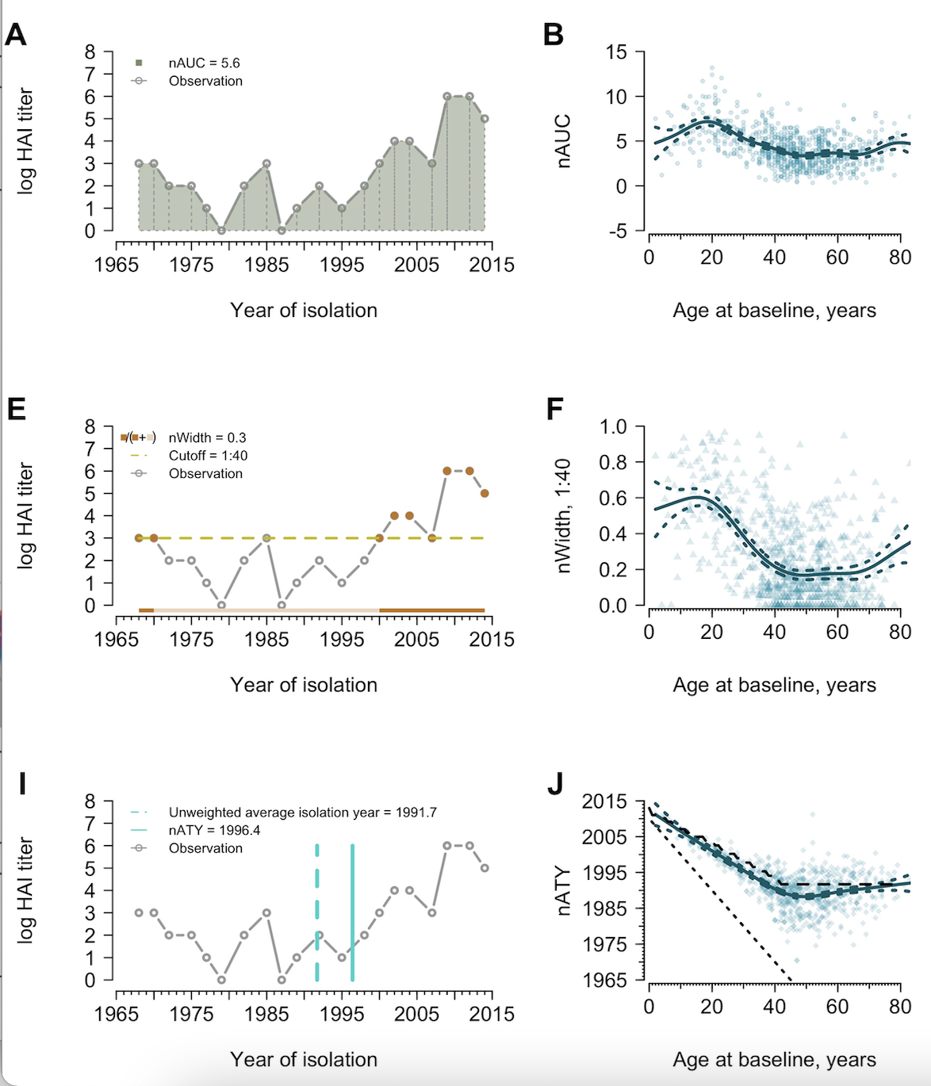
Metrics of Antibody Profiles
Area under the curve
Exclusion of pre-birth strains
Proportion out of 1
Threshold decided by researcher
1:40 used for protection
1:10 used for detection
Proportion of time above threshold
How immunity to strains circulating at different times contributes to the overall immune profile
Childhood biased: year is closer to birth year
Equally biased: year is half the age of the individual
Average Titer year
Yang B, Lessler J, Zhu H, Jiang CQ, Read JM, Hay JA, et al. (2020) Life course exposures continually shape antibody profiles and risk of seroconversion to influenza. PLoS Pathog 16(7): e1008635. https://doi.org/10.1371/journal.ppat.1008635

Slide 19
Summary
Representative Panel and count the response
Antigenic Landscape by strain
HAI titer VS the strain (categorical)
Antigenic Landscape by year
HAI titer VS the year of virus isolation (continuous)
Antigenic Landscape by Antigenic Distance
HAI titer VS the distance from the beginning of a summary path
HAI titer VS the distance from specified starting point
Quantification:
Area under the curve, change in profiles, width of the time frame, average titer year
Increasing in Information

Slide 20
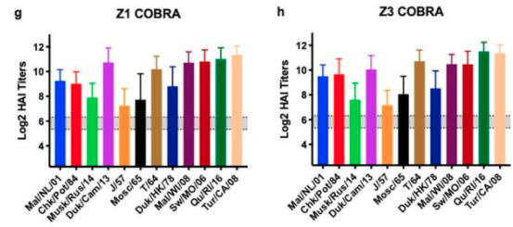
Overall
Antigenic distances can be calculated using different assays
Antigenic landscapes incorporate the difference between tested strains and the magnitude of the antibody response
Potential to include multiple assay results
Visualization of high dimensional date
Which vaccine performed better?
Reneer, et. al. 2020. Computationally Optimized Broadly Reactive H2 HA Influenza Vaccines Elicited Broadly Cross-Reactive Antibodies and Protected Mice from Viral Challenges. 10.1128/JVI.01526-20

Slide 21
Discussion
Quantification of breadth would allow for rigorous vaccine selection
Defining thresholds and values for selection instead of guessing which vaccine to move to the next stage
Weighting can be added
If it’s more advantageous for the vaccine to protect against human H1N1 instead of swine H1N1, then the selection criteria can be adjusted
Inclusion of different assays
Comparison of different research groups results
Antigenic distances allows for comparison of groups that are using different viruses
Bris/18 and MI/15 have similar distances but are three years apart

Slide 22
Extra slides

Slide 23
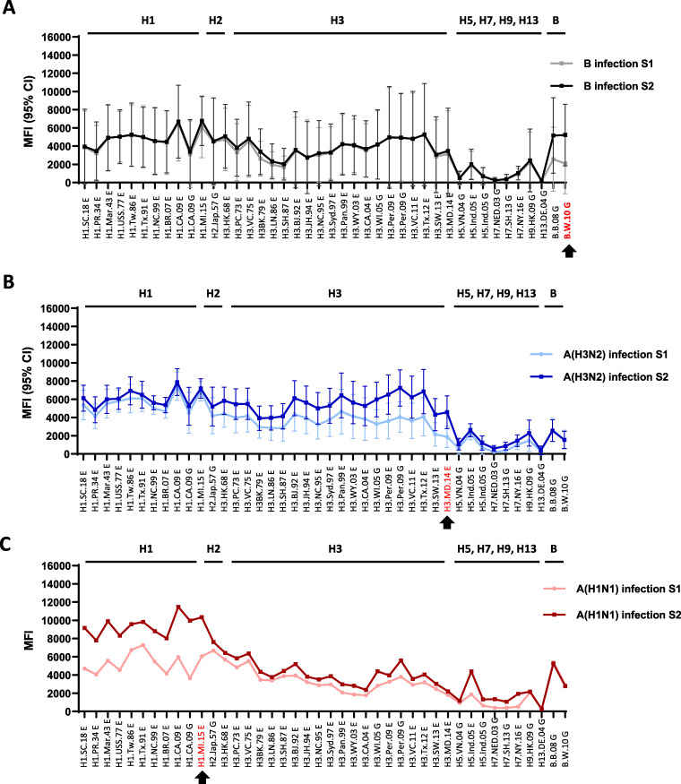
Antigenic Landscapes without Distances
Using multiplex influenza antibody detection assay
Pre and post vaccination with IIV
Acute (S1) and Convalescent Sera (S2) after Influenza B, H3N2 or H1N1 infection
Li, Z. N., Liu, F., Gross, F. L., Kim, L., Ferdinands, J., Carney, P., Chang, J., Stevens, J., Tumpey, T., & Levine, M. Z. (2021). Antibody Landscape Analysis following Influenza Vaccination and Natural Infection in Humans with a High-Throughput Multiplex Influenza Antibody Detection Assay. mBio, 12(1), e02808-20. https://doi.org/10.1128/mBio.02808-20

Slide 24
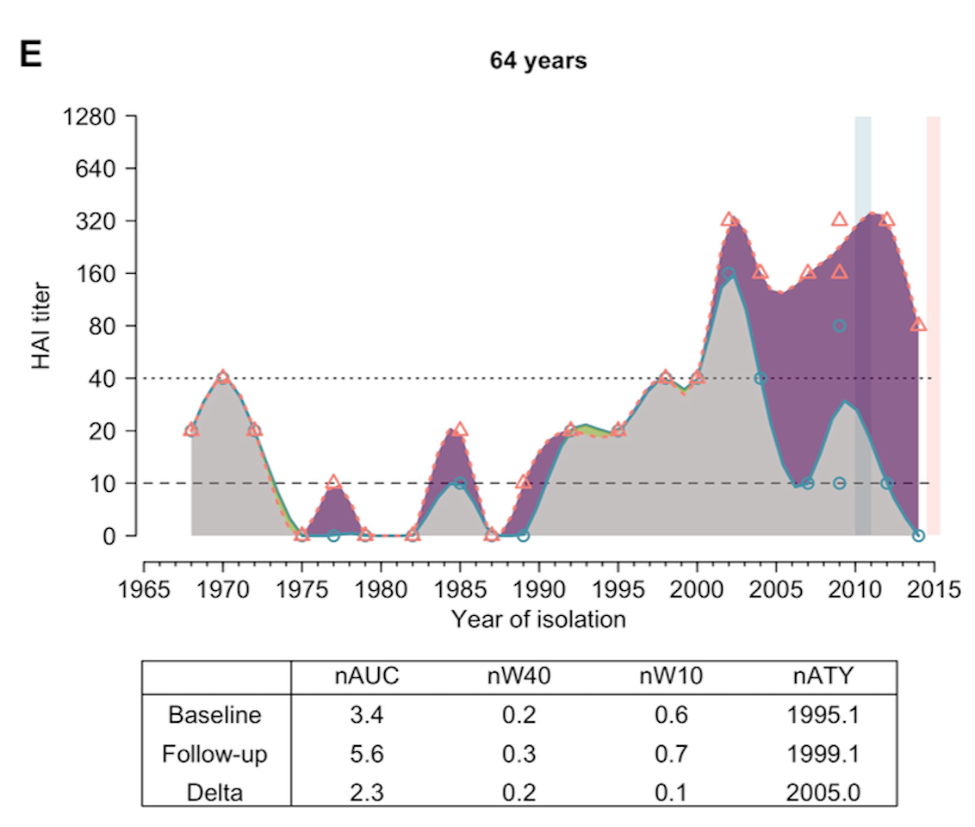
Antigenic Landscapes without Distances
Fluscape cohort
Age: 2-86 years
H3N2 testing
Used to study antibody profiles
Yang B, Lessler J, Zhu H, Jiang CQ, Read JM, Hay JA, et al. (2020) Life course exposures continually shape antibody profiles and risk of seroconversion to influenza. PLoS Pathog 16(7): e1008635. https://doi.org/10.1371/journal.ppat.1008635

Slide 25
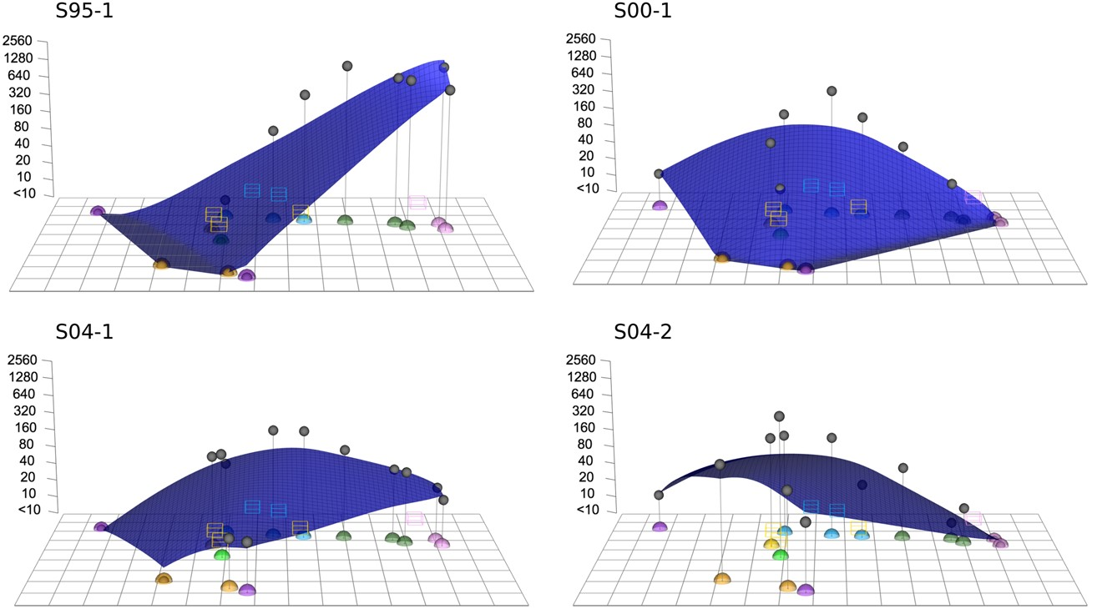
Antigenic Landscapes with Summary Path
Titer pattern of an individual's serum
Children 9-24 months
H3N2 landscapes
Compared naïve children to naïve ferret responses
Judith M. Fonville, Pieter L. A. Fraaij, Gerrie de Mutsert, Samuel H. Wilks, Ruud van Beek, Ron A. M. Fouchier, Guus F. Rimmelzwaan, Antigenic Maps of Influenza A(H3N2) Produced With Human Antisera Obtained After Primary Infection, The Journal of Infectious Diseases, Volume 213, Issue 1, 1 January 2016, Pages 31–38, https://doi.org/10.1093/infdis/jiv367

Slide 26
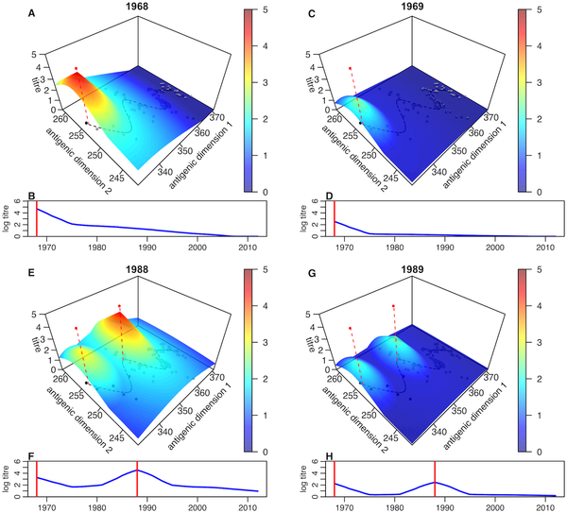
Antigenic Landscapes with Summary Path
Short and long term Antibody Dynamics
Longitudinal Human cohort from Vietnam
Visualization of backboosting
H3N2 cartography
Identified specific years with a high probability of infection
Kucharski AJ, Lessler J, Cummings DAT, Riley S (2018) Timescales of influenza A/H3N2 antibody dynamics. PLOS Biology 16(8): e2004974. https://doi.org/10.1371/journal.pbio.2004974
https://journals.plos.org/plosbiology/article?id=10.1371/journal.pbio.2004974

Slide 27
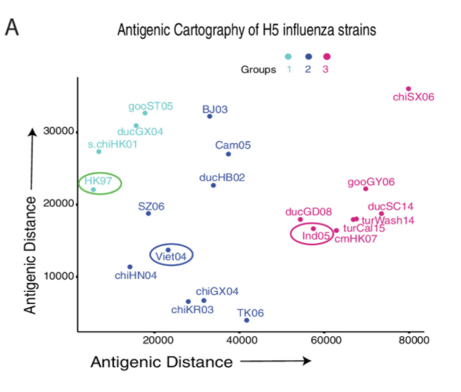
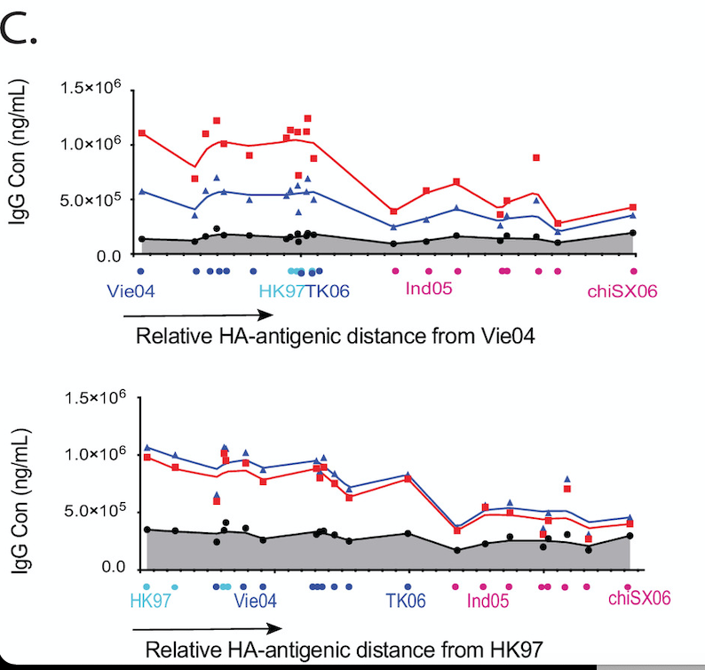
Antibody Landscapes with Relative Distance
Relative Antibody Landscape
Antigenic distance between the vaccine influenza strain and other H5 strains
Unclear if distance along a summary path or the Euclidean distance
mPlex-Flu assay
H5N1
Wang J, Li D, Perry S, Hilchey SP, Wiltse A, Treanor JJ, Sangster MY, Zand MS. Broadly Reactive IgG Responses to Heterologous H5 Prime-Boost Influenza Vaccination Are Shaped by Antigenic Relatedness to Priming Strains. mBio. 2021 Aug 31;12(4):e0044921. doi: 10.1128/mBio.00449-21. Epub 2021 Jul 6. PMID: 34225490; PMCID: PMC8406322.

Slide 28
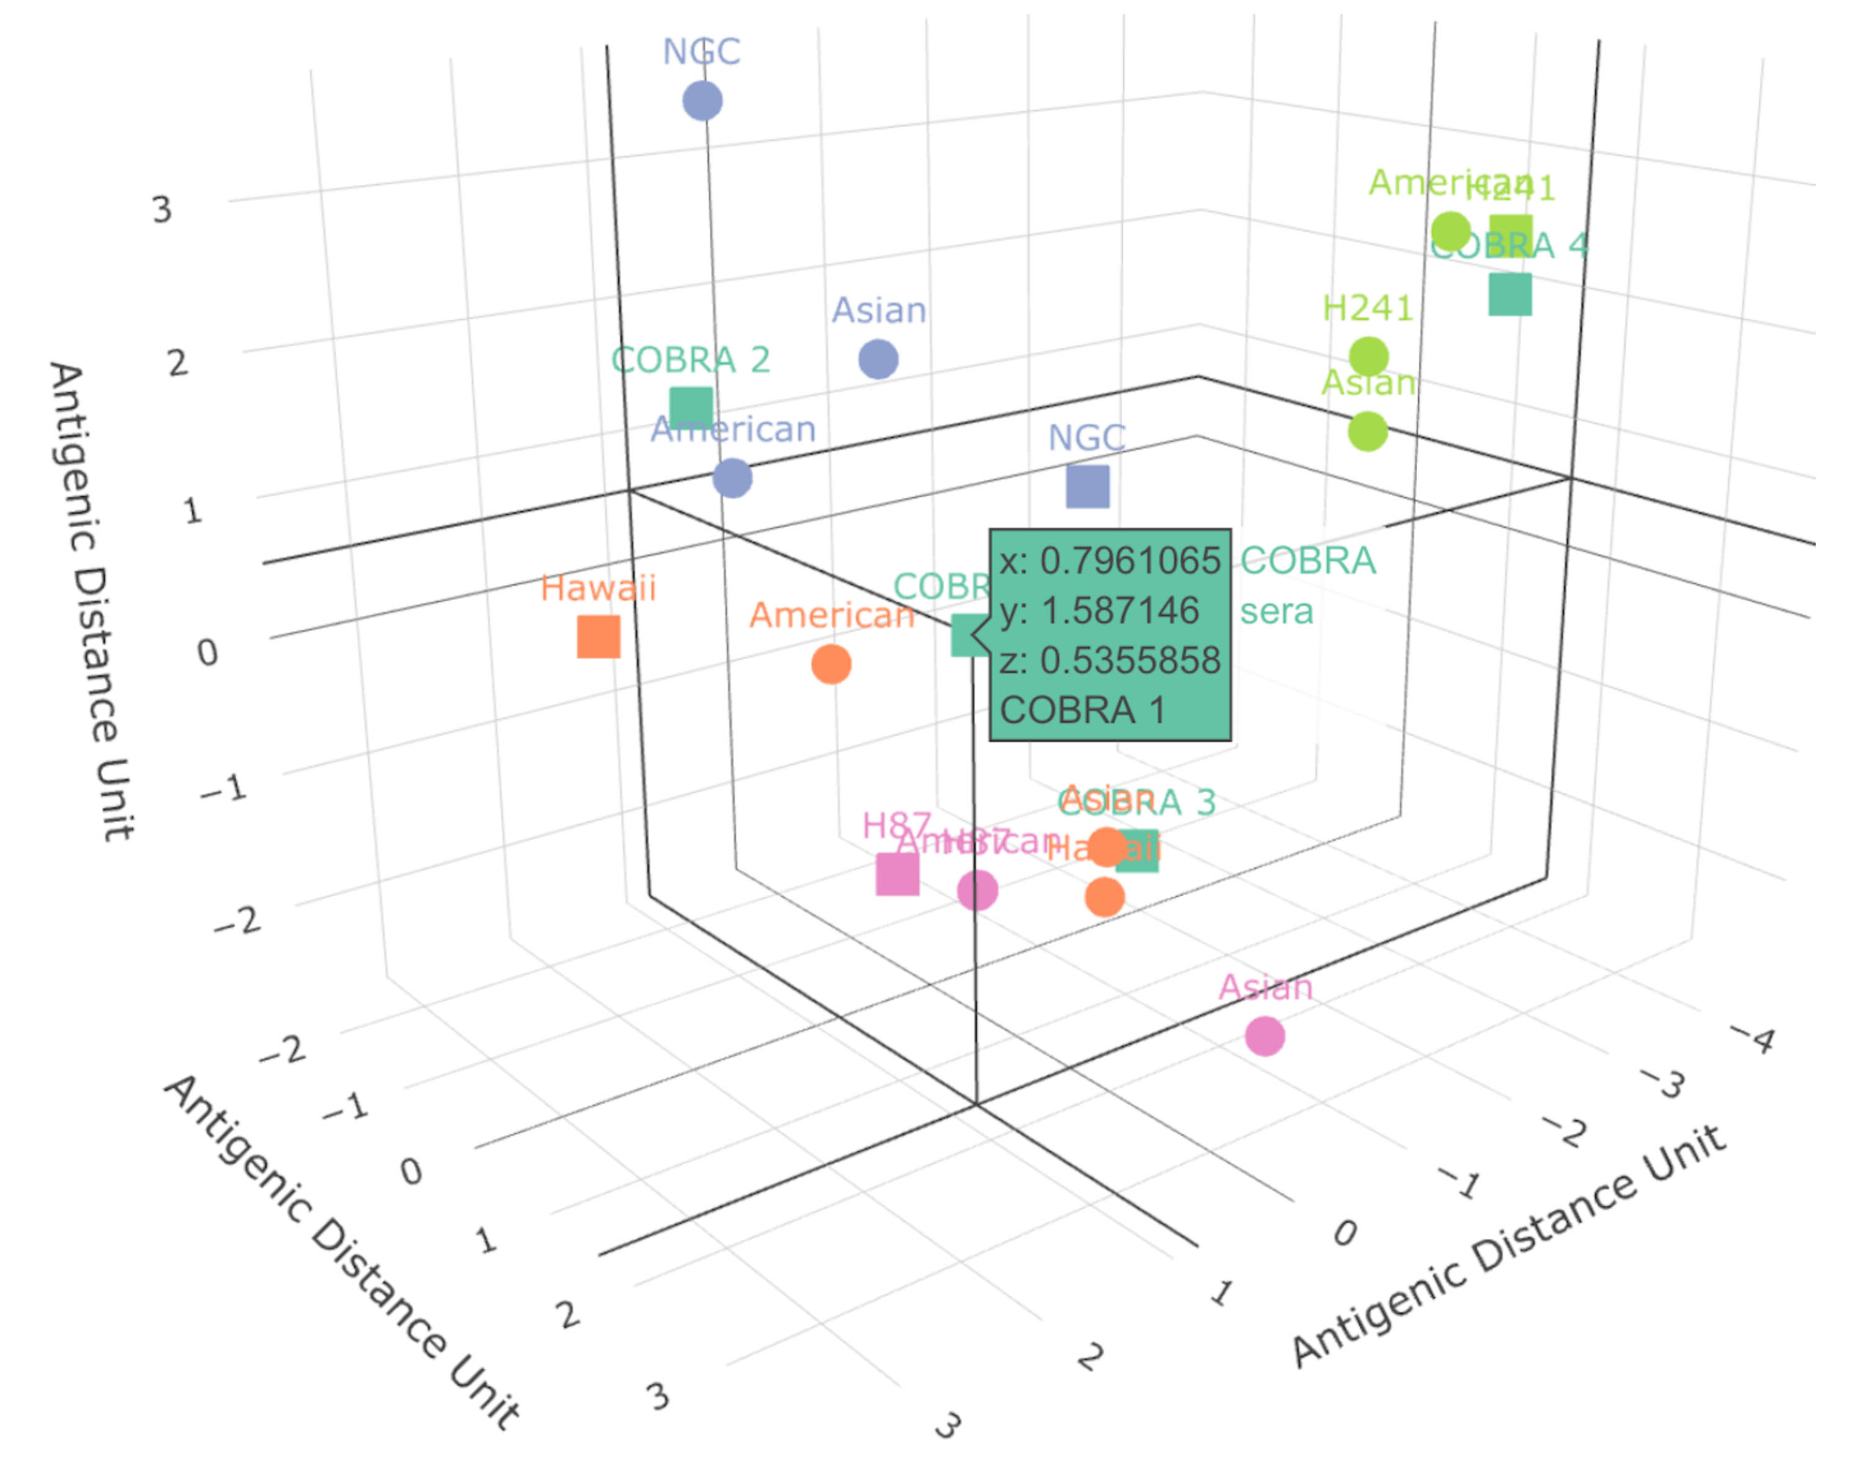
How can antigenic cartography used for breadth?

